Slide 1
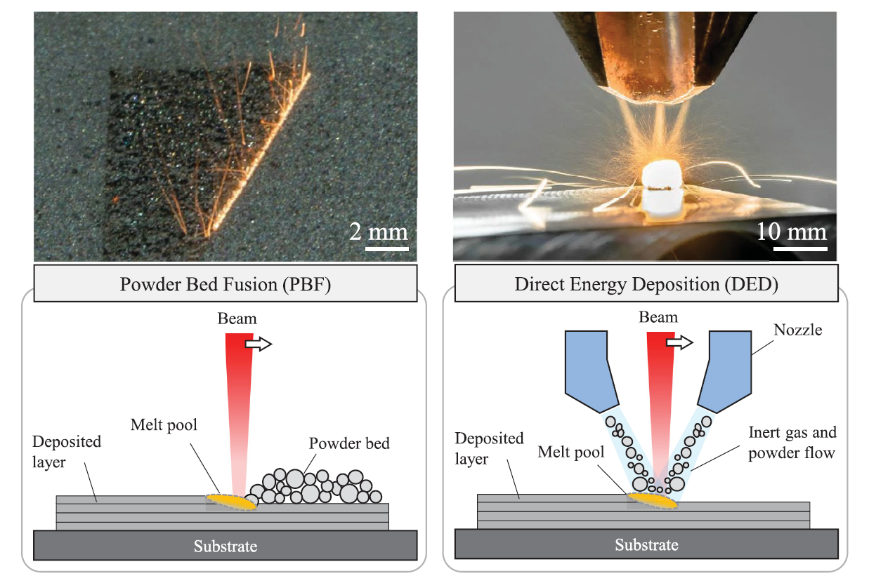
Powder Bed Fusion (PBF)
Directed Energy Deposition (DED)

Slide 2
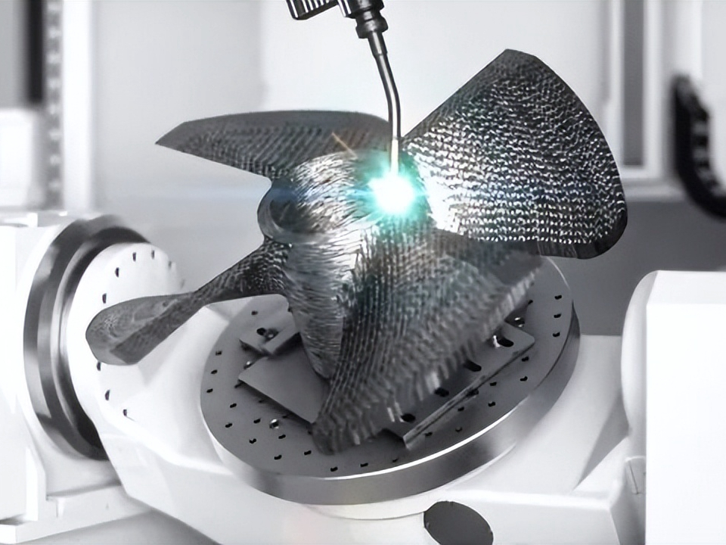
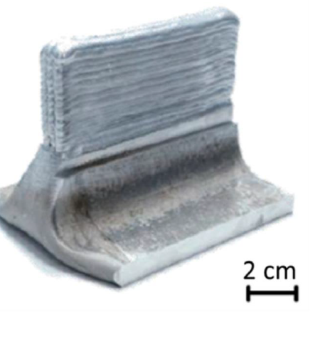
Powder Bed Fusion (PBF)
Directed Energy Deposition (DED - ARC)
Electron Beam Melting
EBM
Vat Photopolymerization VPP
Binder Jetting (glue) BJ
Material Jetting MJ
Sheet Lamination (cut) SHL
Classificações A.M.:
Por fonte de energia
Por tipo de material
Wire Arc
WAAM
Wire DED
GTAW
Arco Voltaico
Modelling and simulation of metal additive manufacturing processes with particle methods: A review https://doi.org/10.1080/17452759.2023.2274494

Slide 3
PROBLEMAS A.M.
1- Orientação – intensidade
2- Descontínuidades (balling)
3- Keyholes (espaços vazios - vapor)
4- Degradação química e oxidação
5- Partículas residuais
6- Trincas
7- Delaminação / Distorção
8- Acabamento superficial
9- Porosidade
Para que modelar?
DED - Arco Voltaico
Racionalizar o problema;
Criar hipóteses
... entender a base de dados;
Controlar o processo de fabricação.
..da solda
Grande quantidade de variáveis !
Aula 3 - ED_Deposicao_por_energia_direcionada

Slide 4
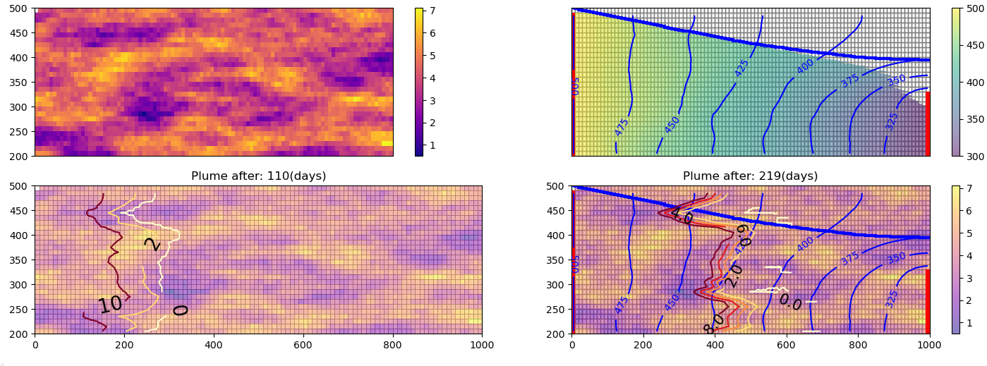
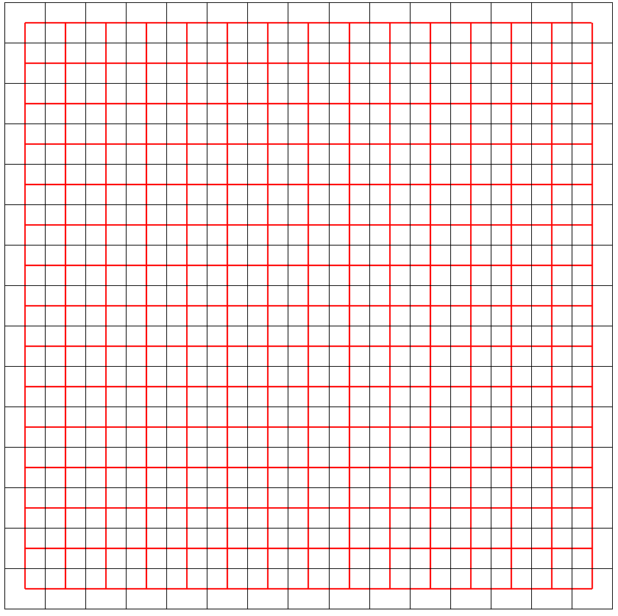
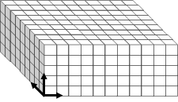

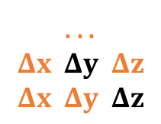
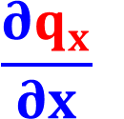


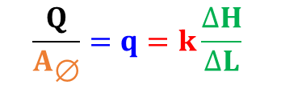


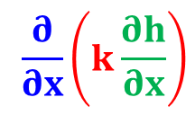

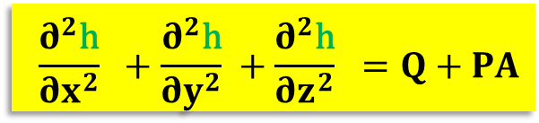

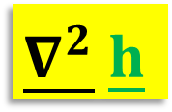

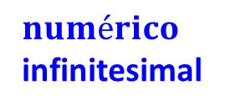
O que é um modelo?
Contexto
Darcy ~ Fourier
$$numérico$$
infinitesimal
Q
$$\frac{Q}{A_{\text{∅}}}=q=k\frac{∆H}{∆L}$$
k (m/d)
$$q$$
$$Hn$$
$$A_{\text{∅}}$$
H₂O
Premissas
ΔH
$$\dot{Q} kA$$
$$( ∆T)/L$$
= -
ΔL
Calor
Q
Δz
$$Δx ΔyΔz$$
$$\frac{{∂q}_{x}}{∂x}$$
. . .
$$Δx Δy Δz$$
$$Δx Δy Δz$$
Condutividade
in
out
Δx
Resultados
$$2D$$
Δy
$$\frac{∂^{2}\text{h}}{∂x^{2}} +\frac{∂^{2}\text{h}}{∂y^{2}} +\frac{∂^{2}\text{h}}{∂z^{2}} =Q+PA$$
$$\frac{∂}{∂x}\left(k\frac{∂h}{∂x}\right)$$
Laplace
$$\underline{∇^{2}} \underline{h}$$
= 𝐟𝐨𝐧𝐭𝐞𝐬
(-) 𝐬𝐮𝐦𝐢𝐝𝐨𝐮𝐫𝐨𝐬
MODFLOW
Carga (hidráulica)
$$3D$$
nabla

Slide 5
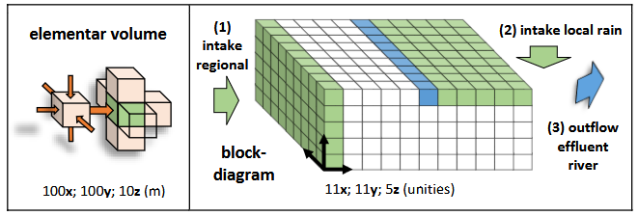
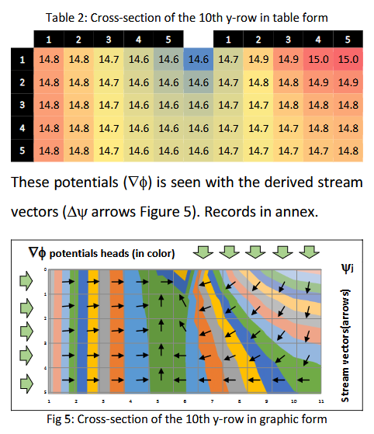
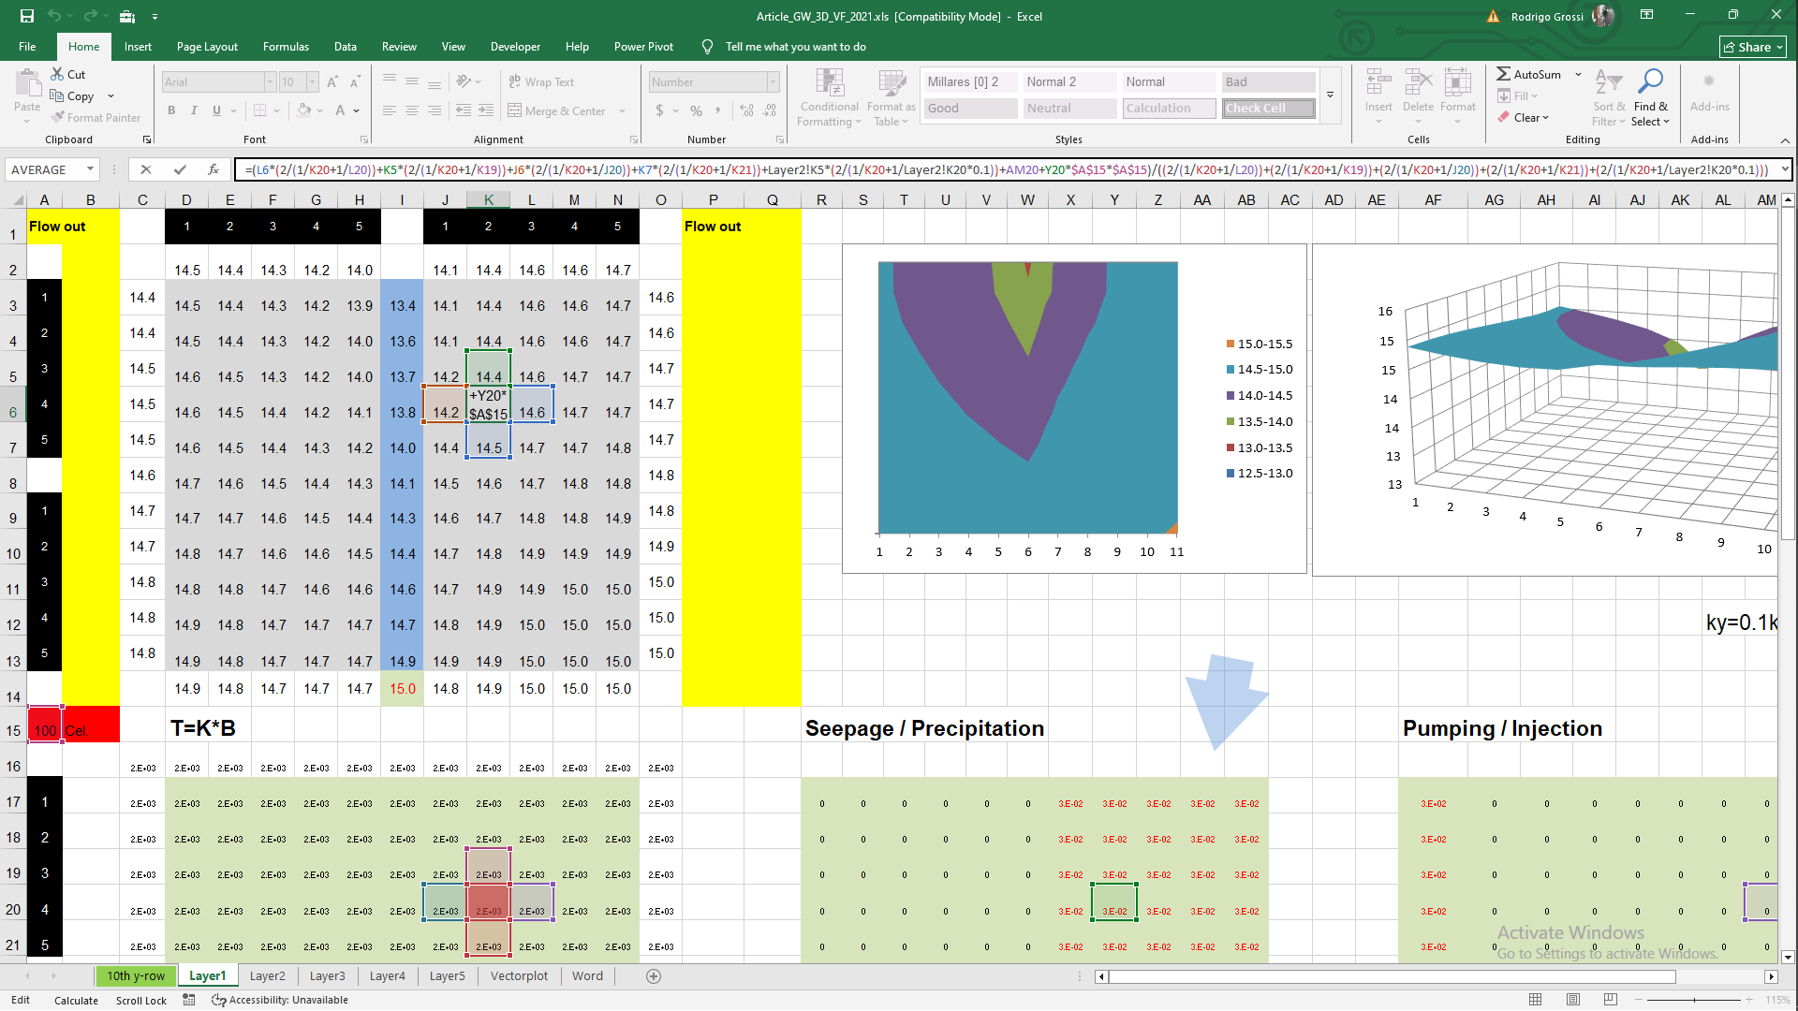



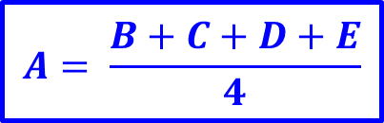
2D
Método de
Diferenças finitas (FDM)
$$A= \frac{B+C+D+E}{4}$$
MODFLOW
E:\15_REPOS\a___________________\10_AM_FEG\Plano_V02_iii_AM_FEG\d.xls
https://betami2022.wixsite.com/betami/home-2/t01-spatial-variances/02-inversion/03-iteractive-solution

Slide 6
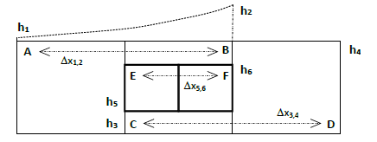


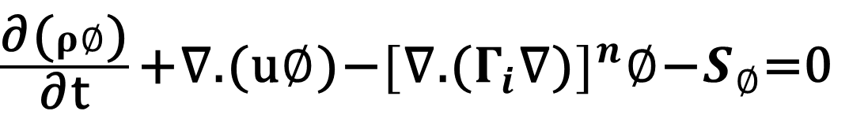
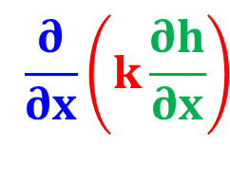
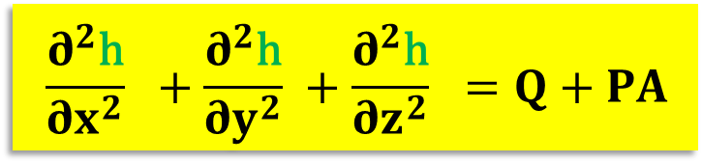
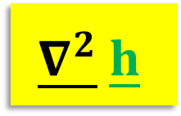
convecção difusão fontes
Método de
Diferenças finitas (FDM)
$\frac{\text{∂}\text{(}ρ∅\text{)}}{\text{∂}\text{t}}\text{+}\text{∇}\text{.}\text{(}\text{u}∅\text{)}\text{−}{[\text{∇}\text{.}\text{(}Γ_{i}\text{∇}\text{)}]}^{n}∅\text{−}S_{∅}\text{=}$0
$$\frac{∂^{2}\text{h}}{∂x^{2}} +\frac{∂^{2}\text{h}}{∂y^{2}} +\frac{∂^{2}\text{h}}{∂z^{2}} =Q+PA$$
$$\underline{∇^{2}} \underline{h}$$
$$\frac{∂}{∂x}\left(k\frac{∂h}{∂x}\right)$$
A
B
E
F
C
D

Slide 7
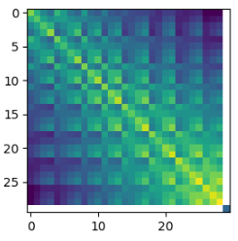
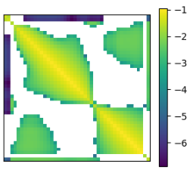
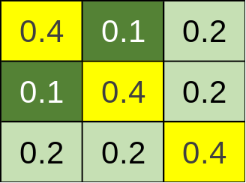
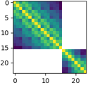
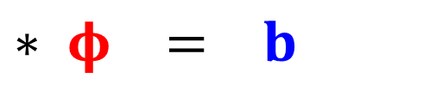
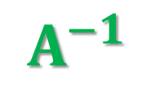
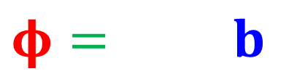
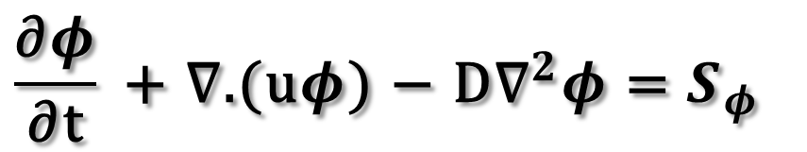
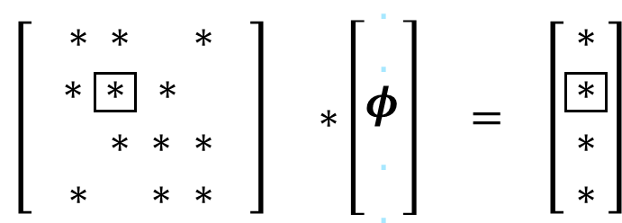

“ pausa ”
convecção difusão fontes
CFD
Otimização Topográfica
$$\frac{\text{∂}φ}{\text{∂}\text{t}} \text{+ }\text{∇}\text{.}\text{(}\text{u}φ\text{)} \text{−} \text{D}{\text{∇}}^{2}φ \text{=} S_{φ}$$
Notações:
Diferencial x Matricial
Sparce matrix
Derivative matrix
Asymmetric matrix
COVariance matrix
Coefficient matrix
Regressor matrix
Design matrix
Jacobian matrix
$$\left[ \begin{aligned}∗ ∗ ∗ ∗ \\ ∗ \boxed{∗} ∗ ∗ \\ ∗ ∗ ∗ ∗ \\ ∗ ∗ ∗ ∗\end{aligned} \right] ∗\left[\begin{matrix}. \\ . \\ \begin{matrix}φ \\ . \\ .\end{matrix}\end{matrix}\right] = \left[\begin{aligned}∗ \\ \boxed{∗} \\ ∗ \\ ∗\end{aligned}\right]$$
Condutividade hidráulica x
- Densidade (Massa)
- Elasticidade
- Rigidez
- Limite de escoamento
load flow
$$A$$
$$∗ φ = b$$
Modelo
OBS
PAR
Probabilidade condicional
Abordagem
Estocástica
$$A^{−1}$$
$$φ= b$$
COV
Zoom +
Inversão

Slide 8





from fipy import Grid1D
import numpy as np
import matplotlib.pyplot as plt
nx=50 ;dx=1. ; mesh=Grid1D(nx=nx,dx=dx)
plt.figure(figsize=(20, 0.5))
FF = mesh.faceCenters() ; X=mesh.faceCenters[0]
plt.xlim(FF.min(),FF.max()) ; plt.xticks(X)
plt.plot (mesh.cellCenters() , np.zeros_like(mesh.cellCenters()) ,'o-’ , markersize=5 ,color='green’)
plt.grid(True, axis=‘x’ , linestyle='--' ,color='red')
finite volume method (FVM)
C1
C2
C3
C4
C5
C6
Python
FiPy
Linguagem orientada a objetos:
Visual Studio
Jupyter Notebook
gri1D.py
Resultado:
GRID 1D
E:\15_REPOS\a___________________\09_CFD_ON\02_FiPy\01_mesh1D_Beta_Diffusion__0__.ipynb

Slide 9
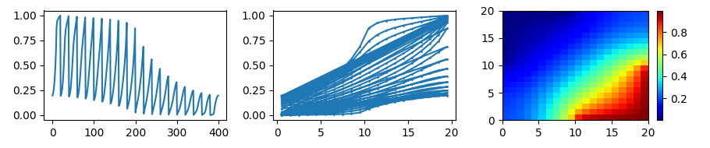
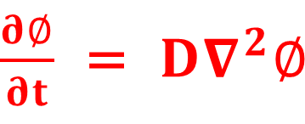
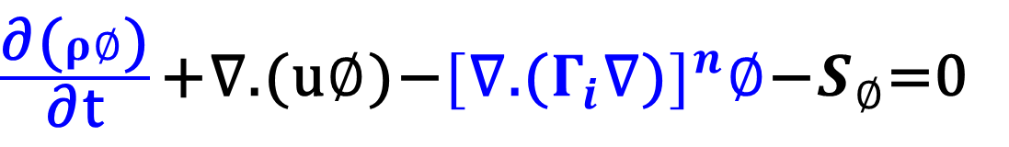
convecção difusão fontes
$\frac{\text{∂}\text{(}ρ∅\text{)}}{\text{∂}\text{t}}\text{+}\text{∇}\text{.}\text{(}\text{u}∅\text{)−}{[\text{∇}\text{.}\text{(}Γ_{i}\text{∇}\text{)}]}^{n}∅\text{−}S_{∅}\text{=}$0
mesh=Grid2D (dx=1,dy=1,nx=20,ny=20)
$\frac{∂∅}{∂t}$ = $D∇^{2}∅$
timeStepDuration = 10 * 0.9 * dx**2 / (2 * D) ; steps = 10
for step in range(steps): eq.solve(var=phi ,dt=timeStepDuration)
Tempo transiente
difusão
YY = phi.value ;XX=np.linspace(0,len(YY)-1,num=len(YY)) ; XA = mesh.cellCenters[0]
xx = mesh.cellCenters[0].value.reshape(nx, ny) ; zz = phi.value
yy = mesh.cellCenters[1].value.reshape(nx, ny) ; ZZ = zz.reshape(nx, ny)
fig, (ax1, ax2, ax3) = plt.subplots(1, 3,figsize=(9, 2))
ax1.plot(XX,YY)
ax2.plot(XA.value,phi.value,'o-',markersize=1) ; WW=ax3.pcolormesh(xx,yy, ZZ,cmap='jet’)
cbar = plt.colorbar(WW) ; plt.tight_layout() ; plt.show()
Resultado:
FiPy
E:\15_REPOS\a___________________\09_CFD_ON\02_FiPy\02_diffusion.mesh20x20.ipynb

Slide 10
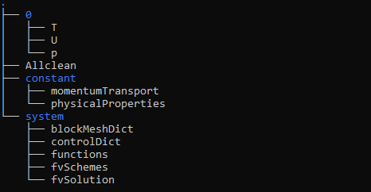

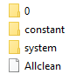
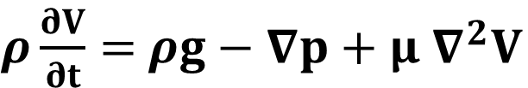

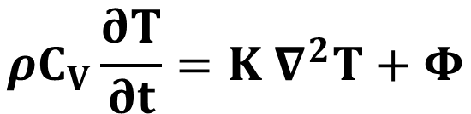
finite volume method (FVM)
PDEs
Partial Differential Equations
===========
\ \ / F ield
\ \ / O peration
\ \ / A nd
\ \ / M anipulation
Open
$$∇.V=0$$
Continuidade
$ρ\frac{∂V}{∂t}=$ $ρg−∇p+μ{ ∇}^{2}V$
Qde de movimento
$$ρC_{V}\frac{∂T}{∂t}=K{ ∇}^{2}T+Φ$$
Energia
https://github.com/grossiRM/CFD_ON/blob/main/04_OpenFoam/03_NOTES-on-CFD_OpenFoam.pdf

Slide 11

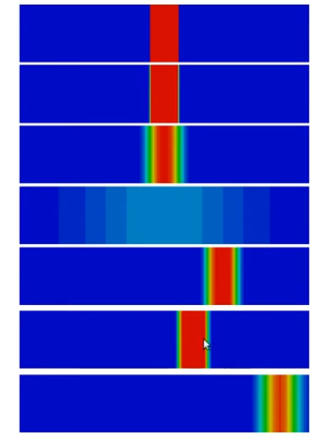


finite volume method (FVM)
PDEs
Partial Differential Equations
===========
\ \ / F ield
\ \ / O peration
\ \ / A nd
\ \ / M anipulation
Open
Convection
source
Diffusion
0
C1
C2
C3
C4
C5
C6
C7
Diffusion
0
Linux
transient
Convection
https://github.com/grossiRM/CFD_ON/blob/main/04_OpenFoam/03_NOTES-on-CFD_OpenFoam.pdf

Slide 12

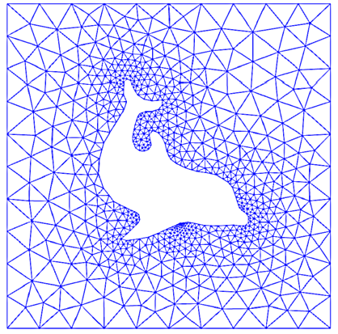
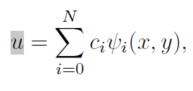



finite elements method (FEM)
PDEs
Partial Differential Equations
Malha triangular
https://github.com/grossiRM/CFD_ON/blob/main/04_OpenFoam/FEniCS/01b__A%20FEniCS%20Tutorial__ii__.pdf
Introduction to Numerical Methods for Variational Problems - Langtangen & Mardal

Slide 13
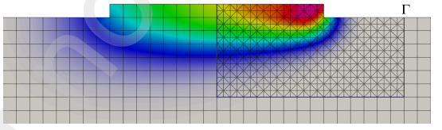

Heat Affected Zone (HAZ)
finite elements method (FEM)
multi-timestep method
the balance of energy equation
+ phase change
+ growing domain
Simulação do processo
Digital twin
moving mesh
moving heat source
& FEniCS
born-dead element technique
Adaptive Mesh Refinement
Exemplo:
docker
A Chimera method for thermal part-scale metal Additive Manufacturing simulation
Substepped and advected subdomain methods for part-scale LPBF modeling
https://github.com/ordinary-slim/moving_heat_source
https://github.com/ordinary-slim/mhs_fenicsx

Slide 14
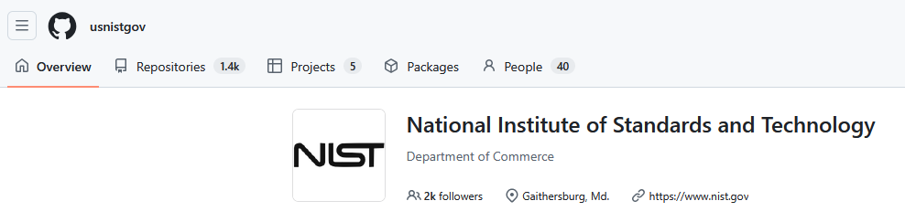
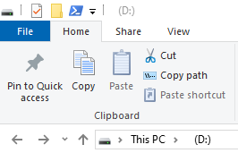
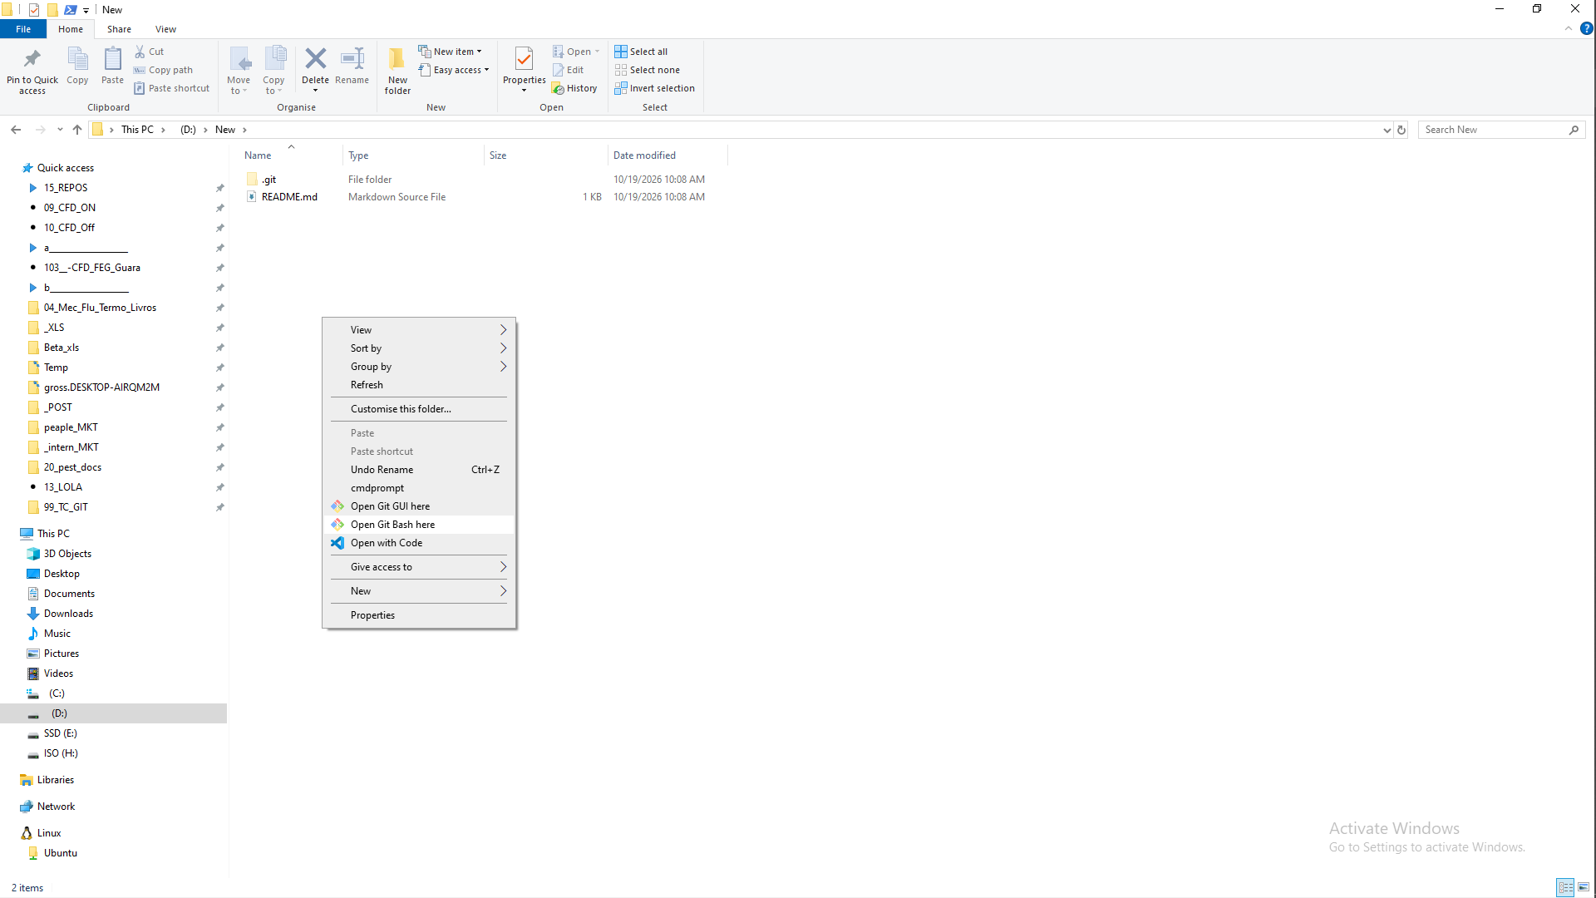
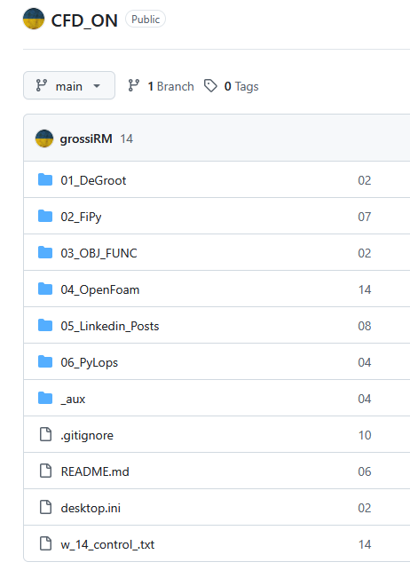
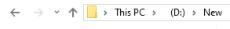
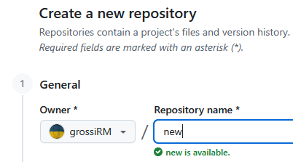


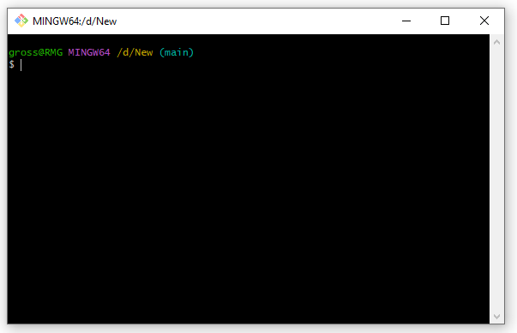

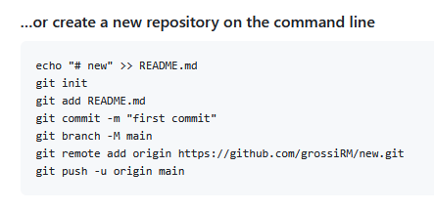

“pausa”
Ecossistema
https://github.com/usnistgov
https://github.com/grossiRM/CFD_ON
https://github.com/new
FiPy
echo "# new" >> README.md
git initgit add README.md
git commit -m "first commit“
git branch -M main
git remote add origin https://github.com/grossiRM/new.git
git push -u origin main
$ git add .
$ git commit -m “001"
$ git push origin

Slide 15



O que modelar?
CAD (Computer-Aided Design) shapes - parametric 3D models (length, width, angles + Rules + History Tree)
CAE (Computer-Aided Engineering) – data harvesting - structural stresses, deformations, displacement, and failures – FEA - CFD
CAM
Computer-Aided Manufacturing
Pós Processamento
Testes, Medições
& controle de qualidade
https://formnext.mesago.com/frankfurt/en/industry-insights/am-field-guide/process_in_general.html

Slide 16

Escalas de modelagem
O que modelar?
Macro-scale models
heat flow and structural (stress) deformation & interlayer bonding,
Meso-scale models
pool geometry, bead formation, and dilution.
Micro-scale phase-field
grain growth, microstructural transitions, solidification kinetics
Distorção, stress residual
Métodos: FEM, FVM
Fluxo, poça de fusão
Métodos: CFD, SPH, LBM
Grãos, nucleação, vazios
Métodos: CA, MC, PF
https://formnext.mesago.com/frankfurt/en/industry-insights/am-field-guide/process_in_general.html

Slide 17




FEA – Análise de Elementos Finitos
- Decompõe um objeto 3D complexo em milhares de pequenas partes gerenciáveis ​​("elementos"); - Calcula tensões estruturais, falhas e deformações.
Como modelar?
Stress, Deformação, Vibração, Fadiga
Análise Estrutural
Peça de Suporte
Fluxo, pressão, temperatura, momento, energia
CFD
- Fluidodinâmica Computacional
FSI – Fluid - Structure Interaction
Hybridization of generative design and TPMS lattices: A statistical approach for lightweight aeronautical components

Slide 18


Como modelar?
FEM | Finite Element Method
Material contínuo
stress e deformação
FEM
DEM
FDEM
DEM | Discrete Element Method
Interação de partículas
Escorregamento, aberturas
FDEM | Finite-Discrete Element Method
Combinação:
= fraturas
deformação + interação de blocos
FDM
Finite-difference
MODFLOW
Finite-volume
OpenFOAM, FiPy
FVM

Slide 19

Como modelar?
Mesh-free
Mesh based
Deterministic
Stochastic
Massive parallelisation
Particle based
Grid based
-
-
1
4
MODFLOW
2
openFOAM
3
PFEM
ML algorithms
-
physics-based . surrogate models.
simulation-informed
closed-loop control feedback real-time monitoring systems
Macro
01 - finite element analysis (FEA)
02 - phase-field modeling techniques
CFD
Design optimization
heat flow, temperature, and stress evolution during deposition
Modelling and simulation of metal additive manufacturing processes with particle methods.

Slide 20






Método de Diferenças finitas (FDM)
Método de Volumes finitos (FVM)
$$f\left(x\right)=$$
$$\sum_{n=0}^{∞}{\frac{f^{\left(n\right)}(a)}{n!} {(x−a)}^{n}}$$
Séries de Taylor
Finite Volume
$$Hn$$
2.3
2.12
Notes on CFD: General Principles - 3.22 Bounded advection discretisation

Slide 21




Meso-scale
Mult—physics
Mult—dimensional
$$∇.V=0$$
Continuidade
$ρ\frac{∂V}{∂t}=$ $ρg−∇p+μ{ ∇}^{2}V$
Qde de movimento
$$ρC_{V}\frac{∂T}{∂t}=K{ ∇}^{2}T+Φ$$
Energia
A review of multi-scale and multi-physics simulations of metal AM processes with focus on modeling strategies

Slide 22





CFD Methodology
https://github.com/DLR-RY/VoFLibrary
CFD
Incompressible, multiphase flow with surface tension and phase change
$\frac{∂α}{∂t}$ + $∇.\left(αu\right)=0$
Volume of
fraction
$α$ = V_{i} / V
$α$ = 0 (solid)
$α$ = 1 (liquid)
$0<α$ < 0 (interface)
Volume of fluid method (VOF)
Continuity Equation (mass conservation)
$∇.u=0$
Surface tension
Marangoni force
Momentum conservation
Laser heat input latent input
Energy conservation
“… the basis of how the simulation solver is modelled and
how we can rely on the data that has been predicted … based on this robust physic equations that are provided ”
AM PravaH®

Slide 23






EX:
arc welding – analytical solution.
Directed Energy Deposition (DED - ARC)
new (x) coordinate system
Convection
Diffusion
k Heat conductivity
R Distance - moving heat source and pt interest
c Specific heat
v Welding speed
ξ Moving coordinate parallel to the welding
An analytical solution for temperature distribution in fillet arc welding based on an adaptive function Bagher & Norbert Enzinger

Slide 24



EX:
arc welding - analytical solution
Directed Energy Deposition (DED - ARC)
Part 01

Slide 25







EX:
Part 02

Slide 26




EX:
Micro-scale
Printed
Laser
Powder Bed Fusion (L PBF)
insight into the solute transport process;
high-fidelity physics-based numerical modelling;
effect of melt convection and solute partition.
Model
210 × 400 µm computational domain (2D)
1,341,561
grid 0.25 μm
Temperature, flow velocity, solute concentration, and microstructure
... directly coupled
Solute trapping and non-equilibrium microstructure during rapid solidification of additive manufacturing

